Slide 1
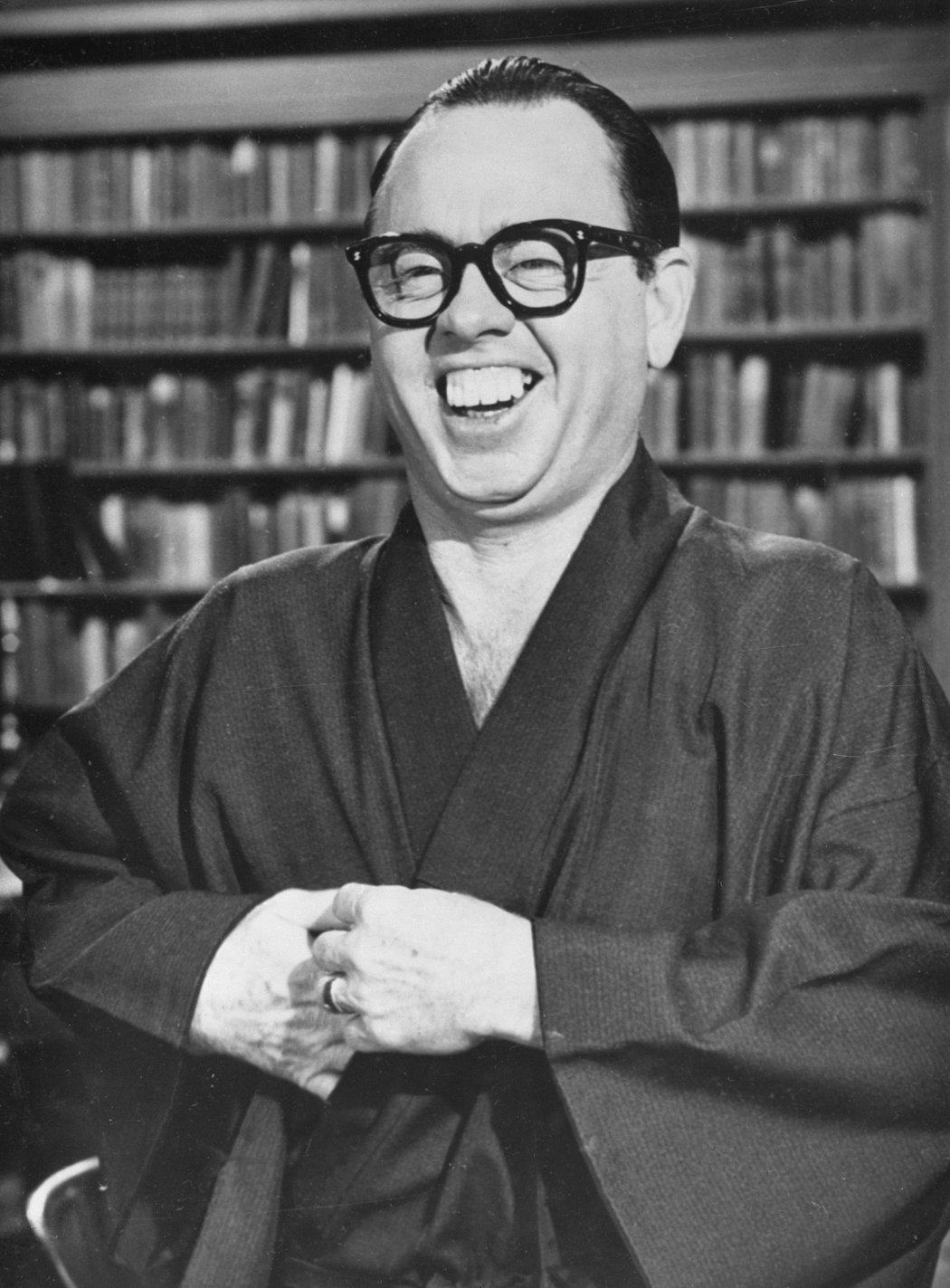



Fook Mi
Fook Yu
Media Representation

